Slide 1
Streams

Slide 2
Problem statement: Find first 3 distinct element from an integer array in asc order
int numbers[] = {4,1,13,90,16,2,0}

Slide 3
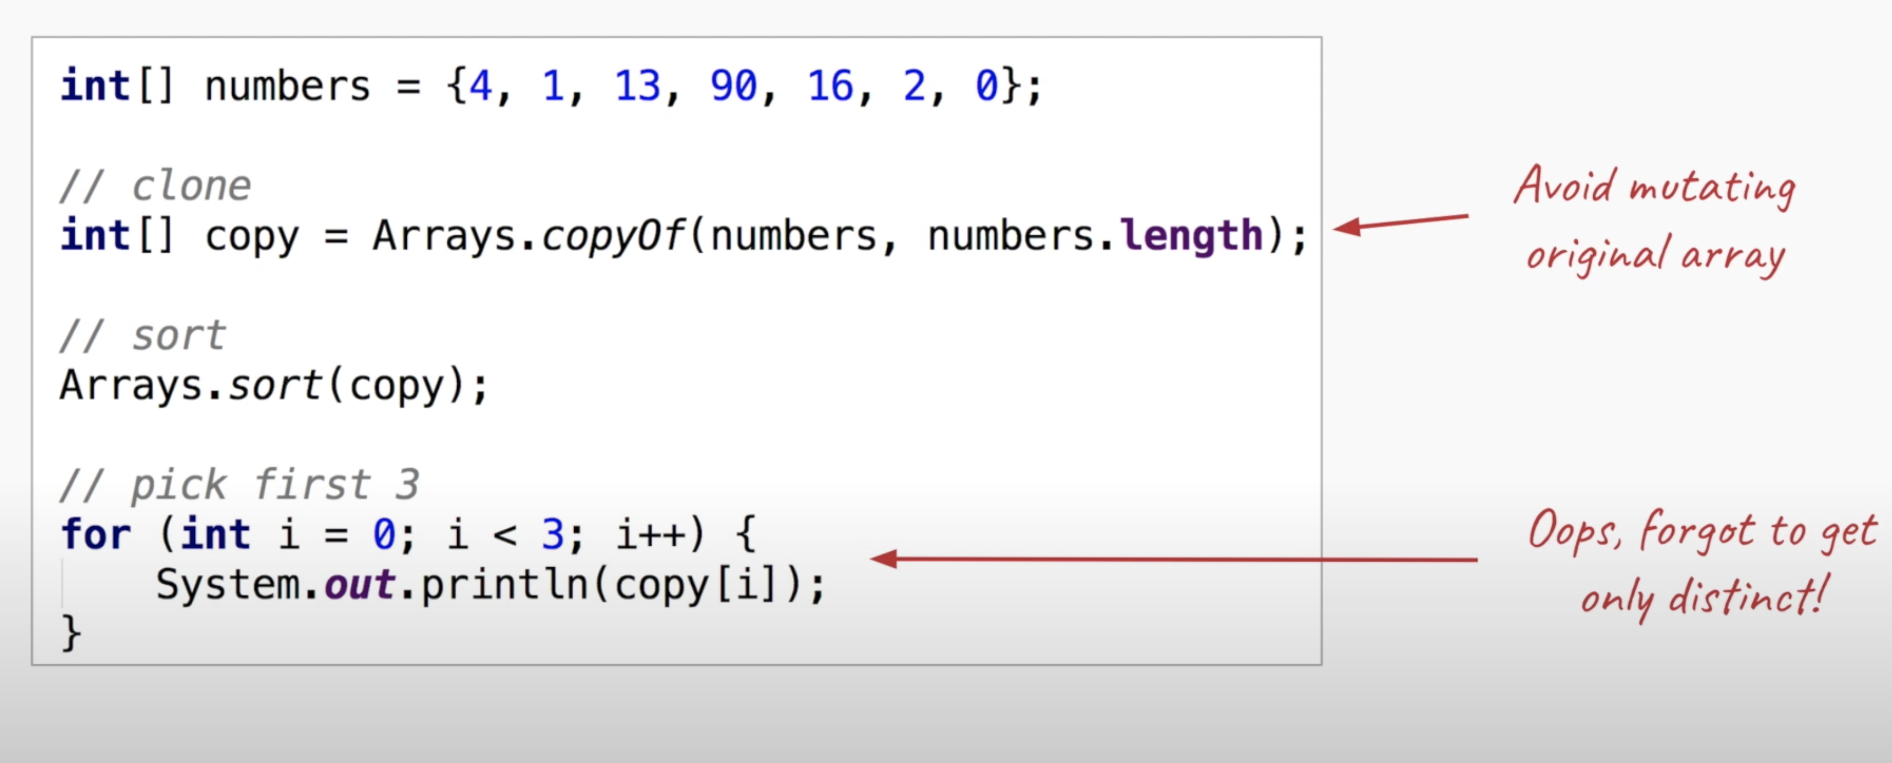

Slide 4
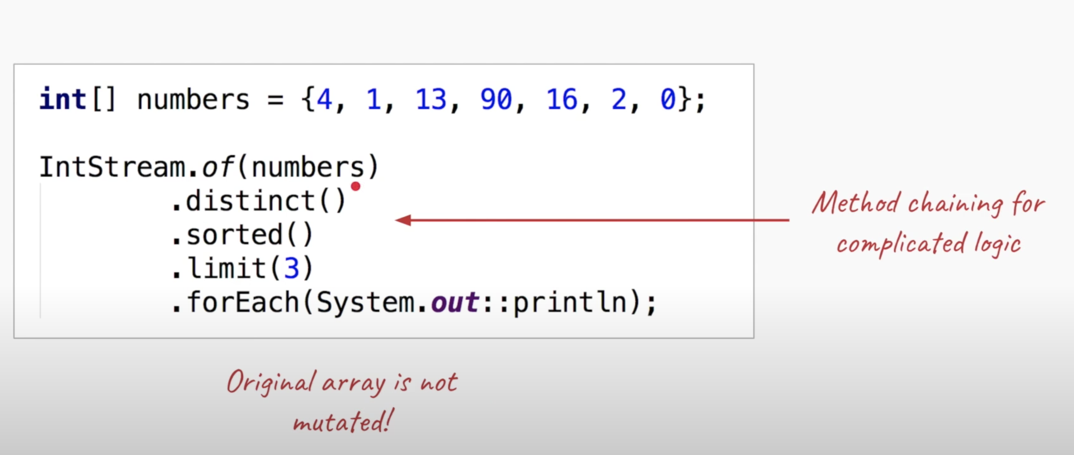
With Java8 Streams

Slide 5
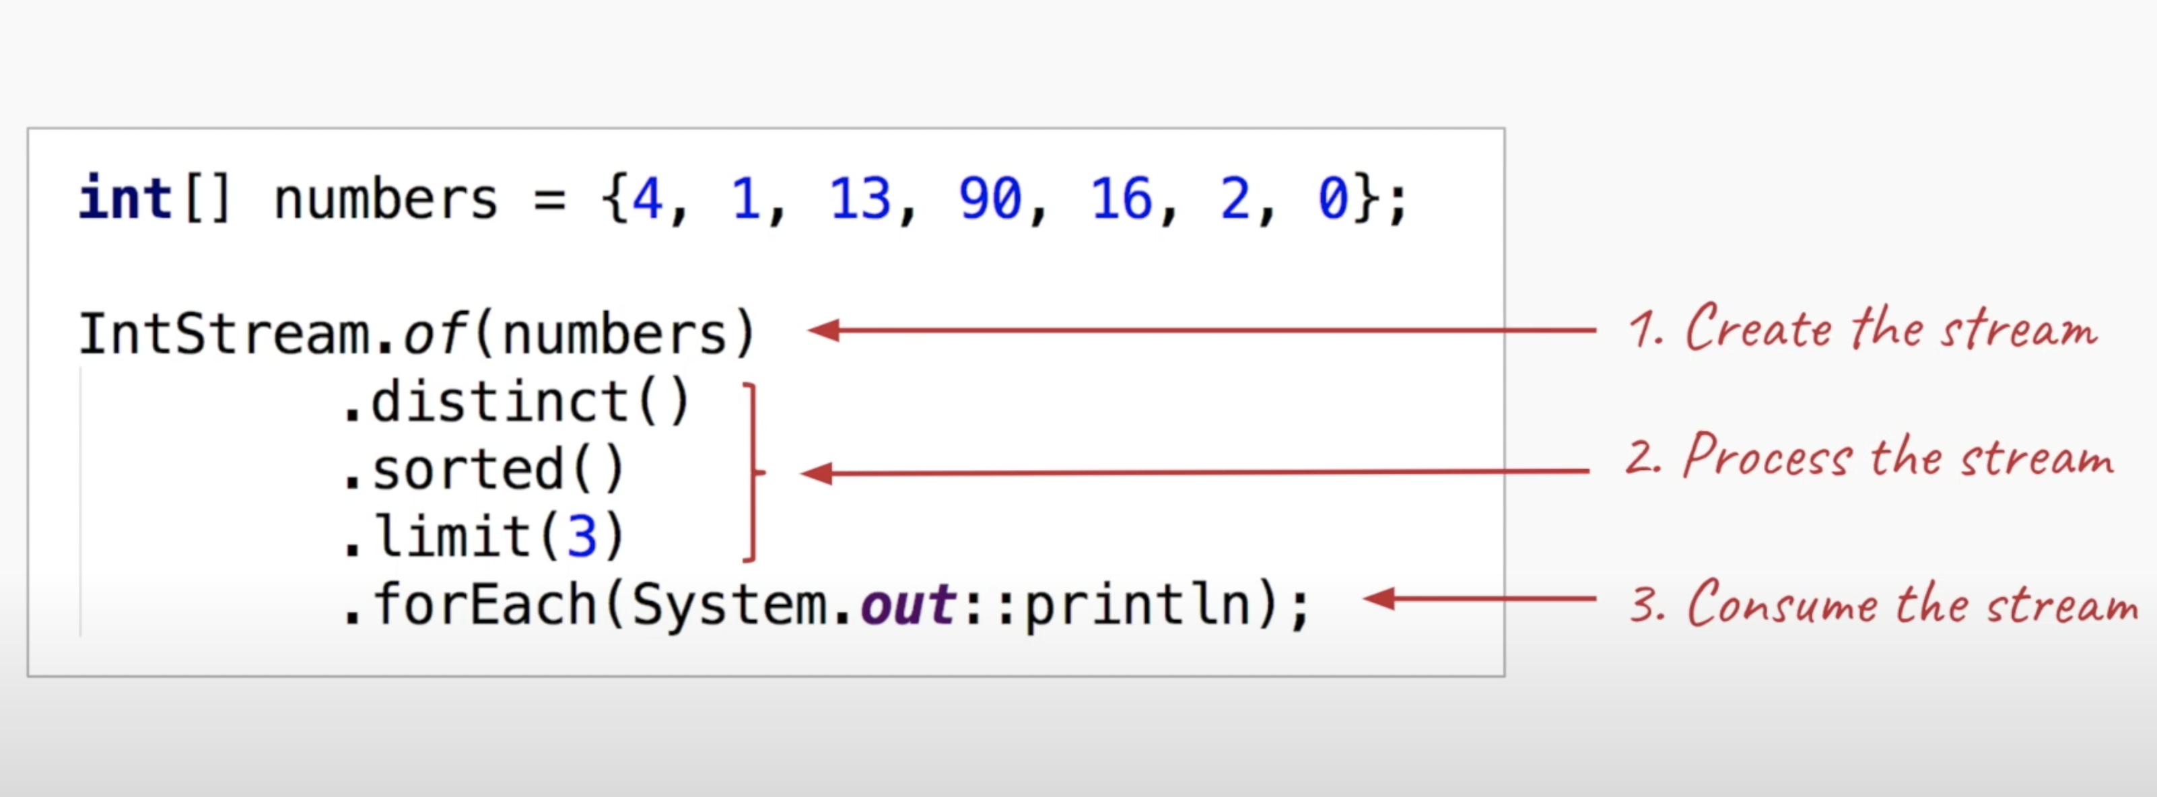
Stream API = Create + Process + Consume

Slide 6
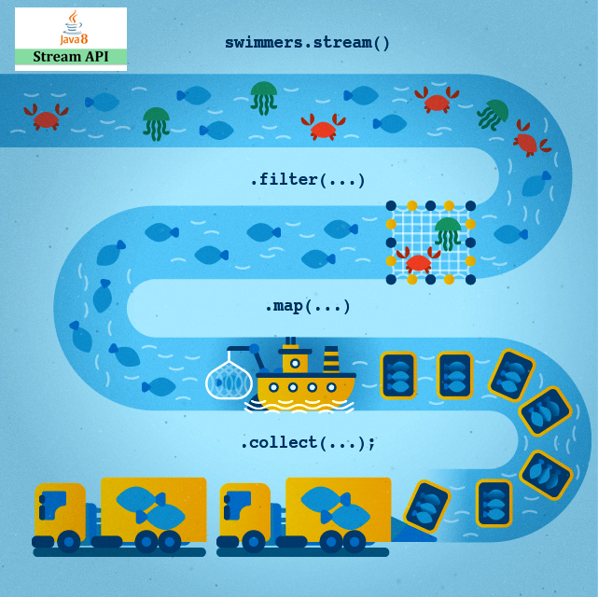

Slide 7
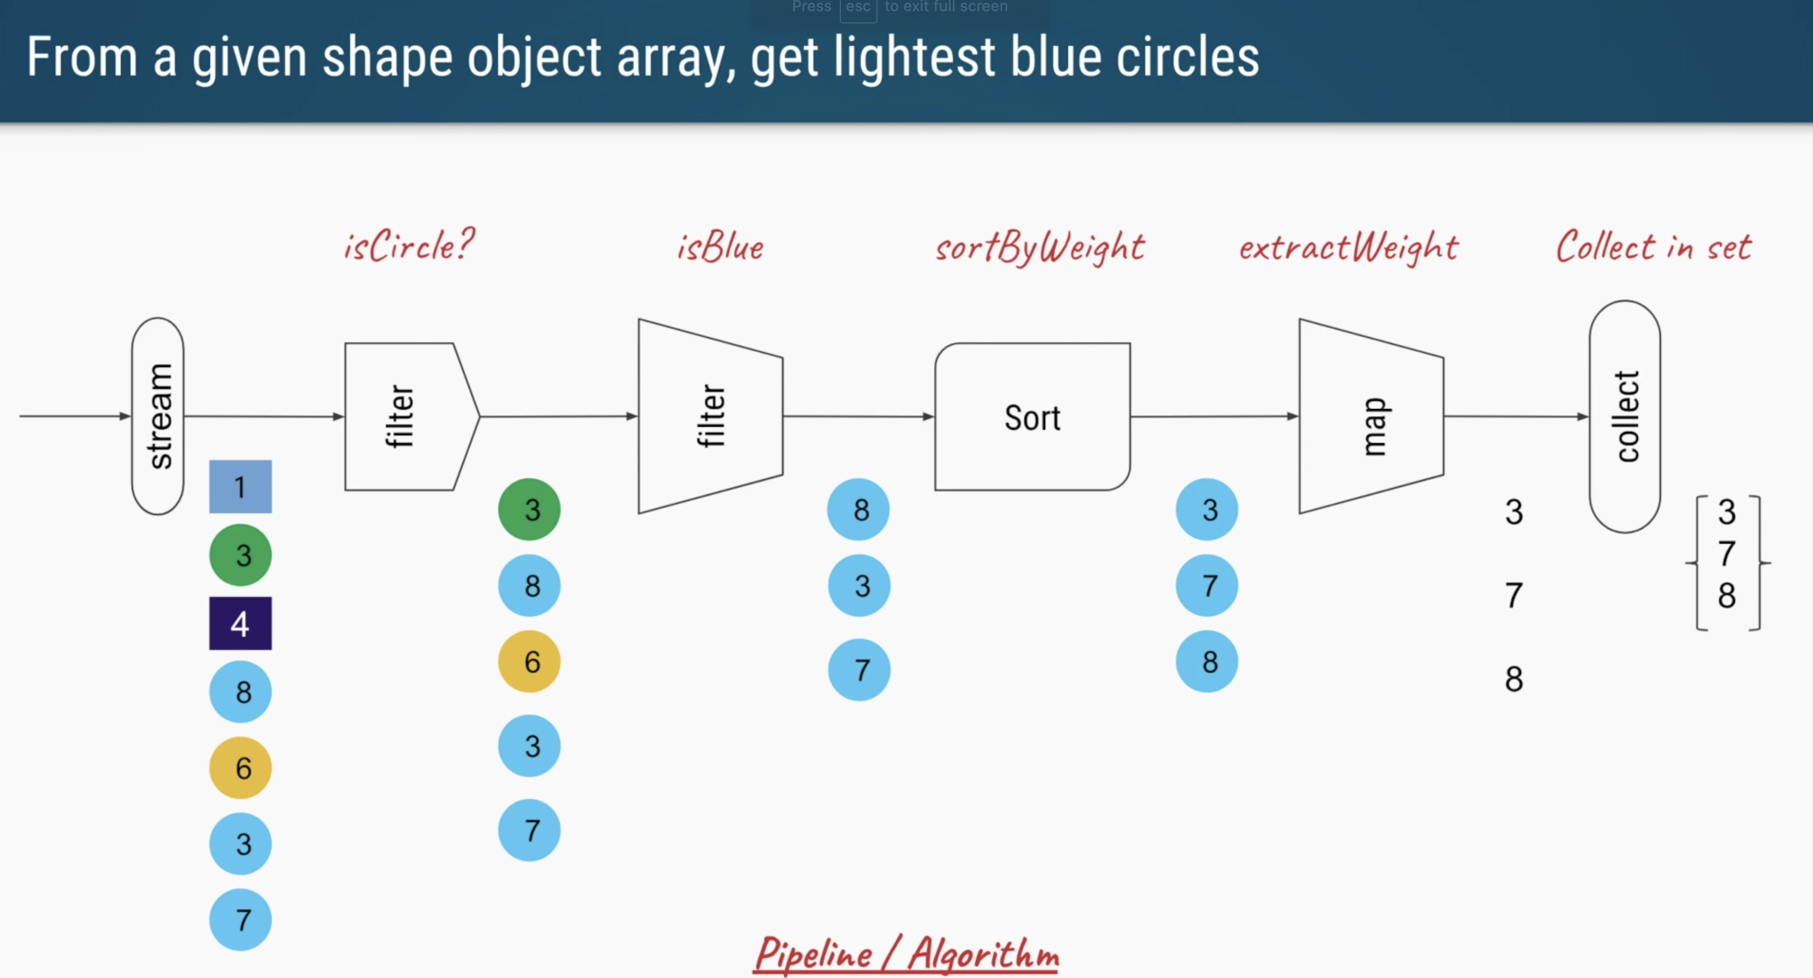

Slide 8
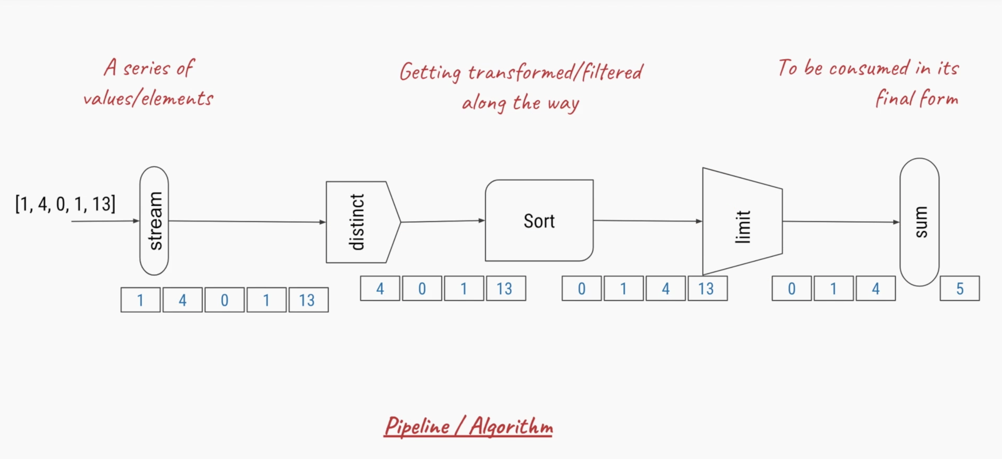
Streams pipeline

Slide 9
Problem statemet2: Find names of 3 highest earning employees from given employee List
List<Employee> employeeList = getAllEmployees(); // db/service calls
Model:
class Employee {
id, name, salary,…
//constructors
//setters and getters
}

Slide 10
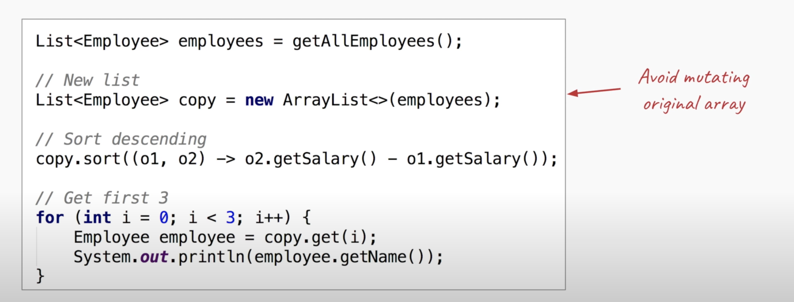
Soluction1

Slide 11
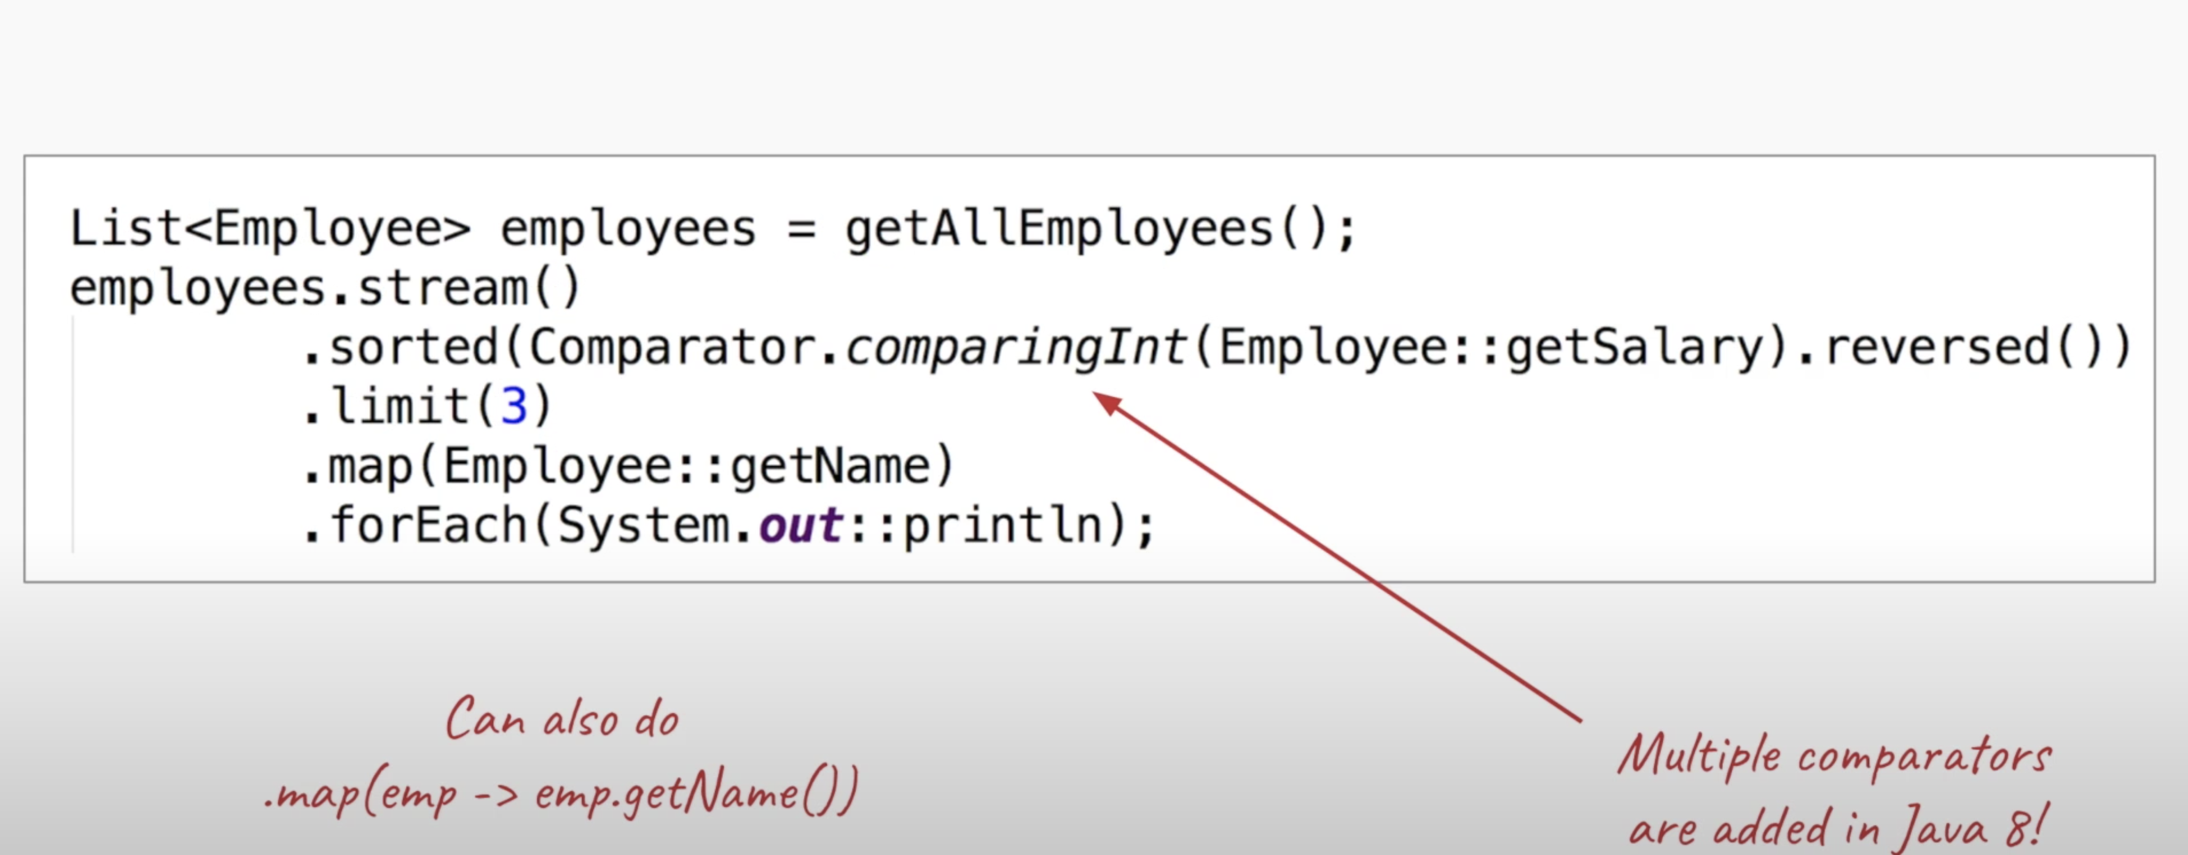
With Steams

Slide 12
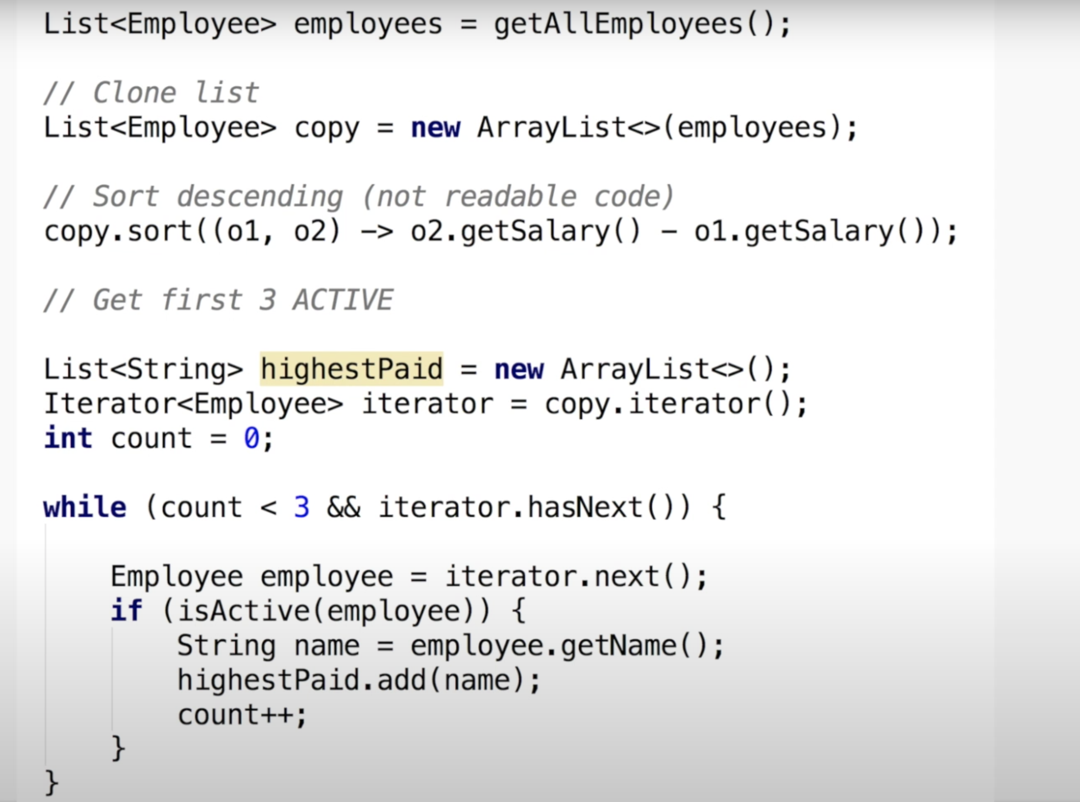
Problem statement 3: Three highest paid employees, who are still in the active firm

Slide 13
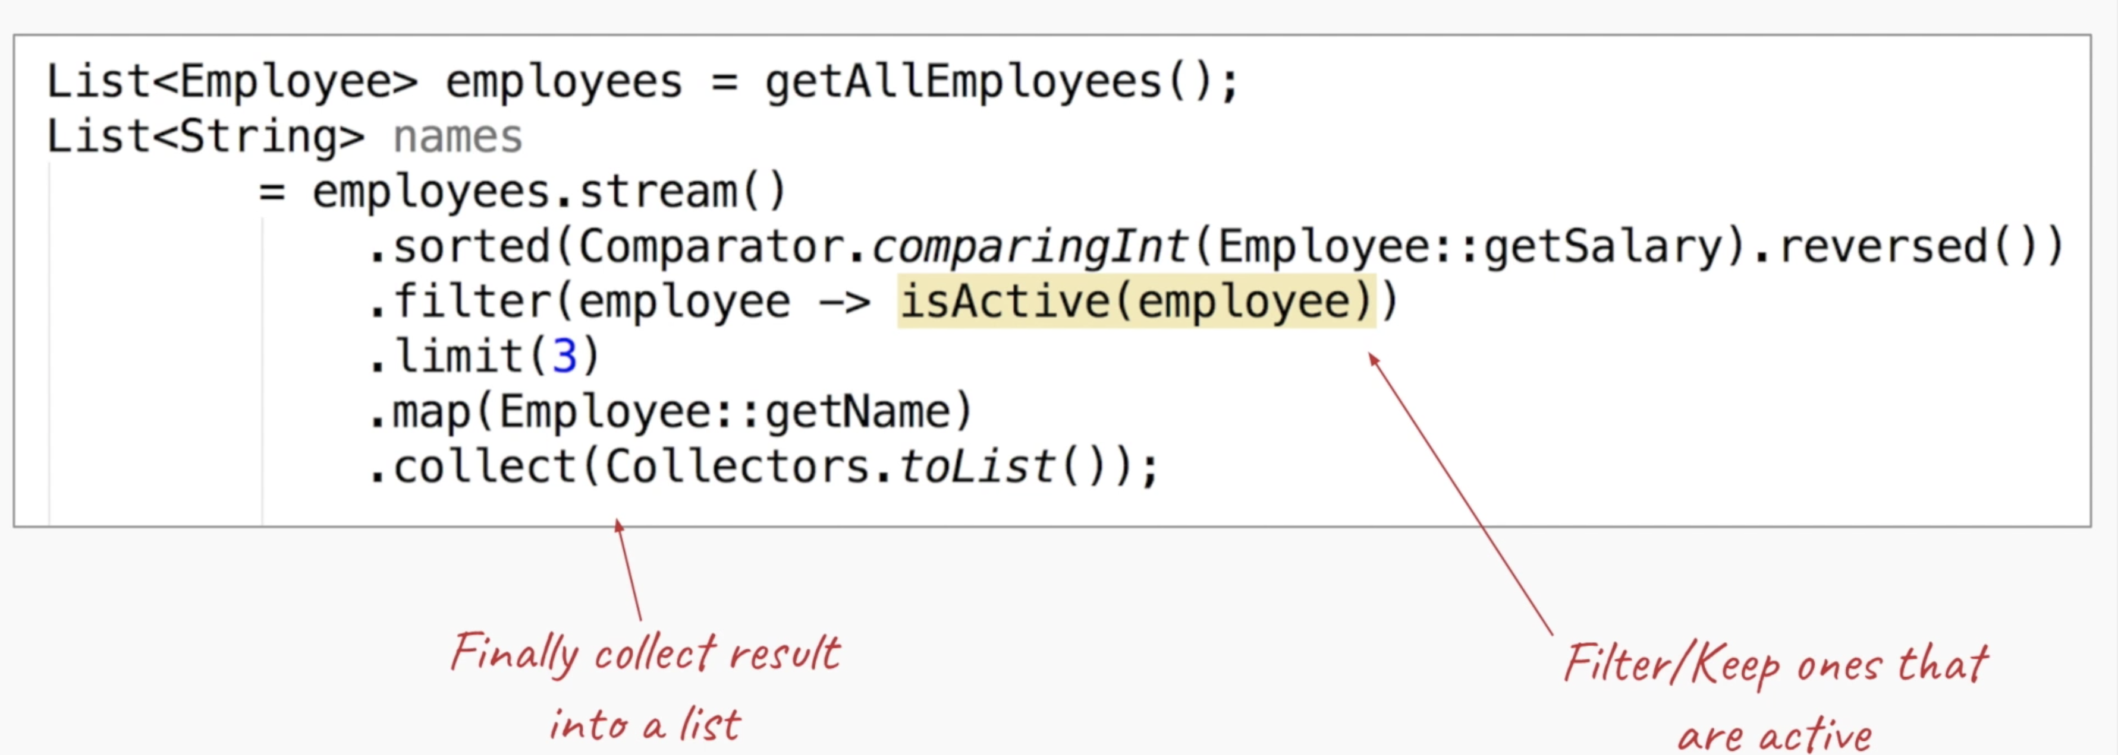
With Streams

Slide 14
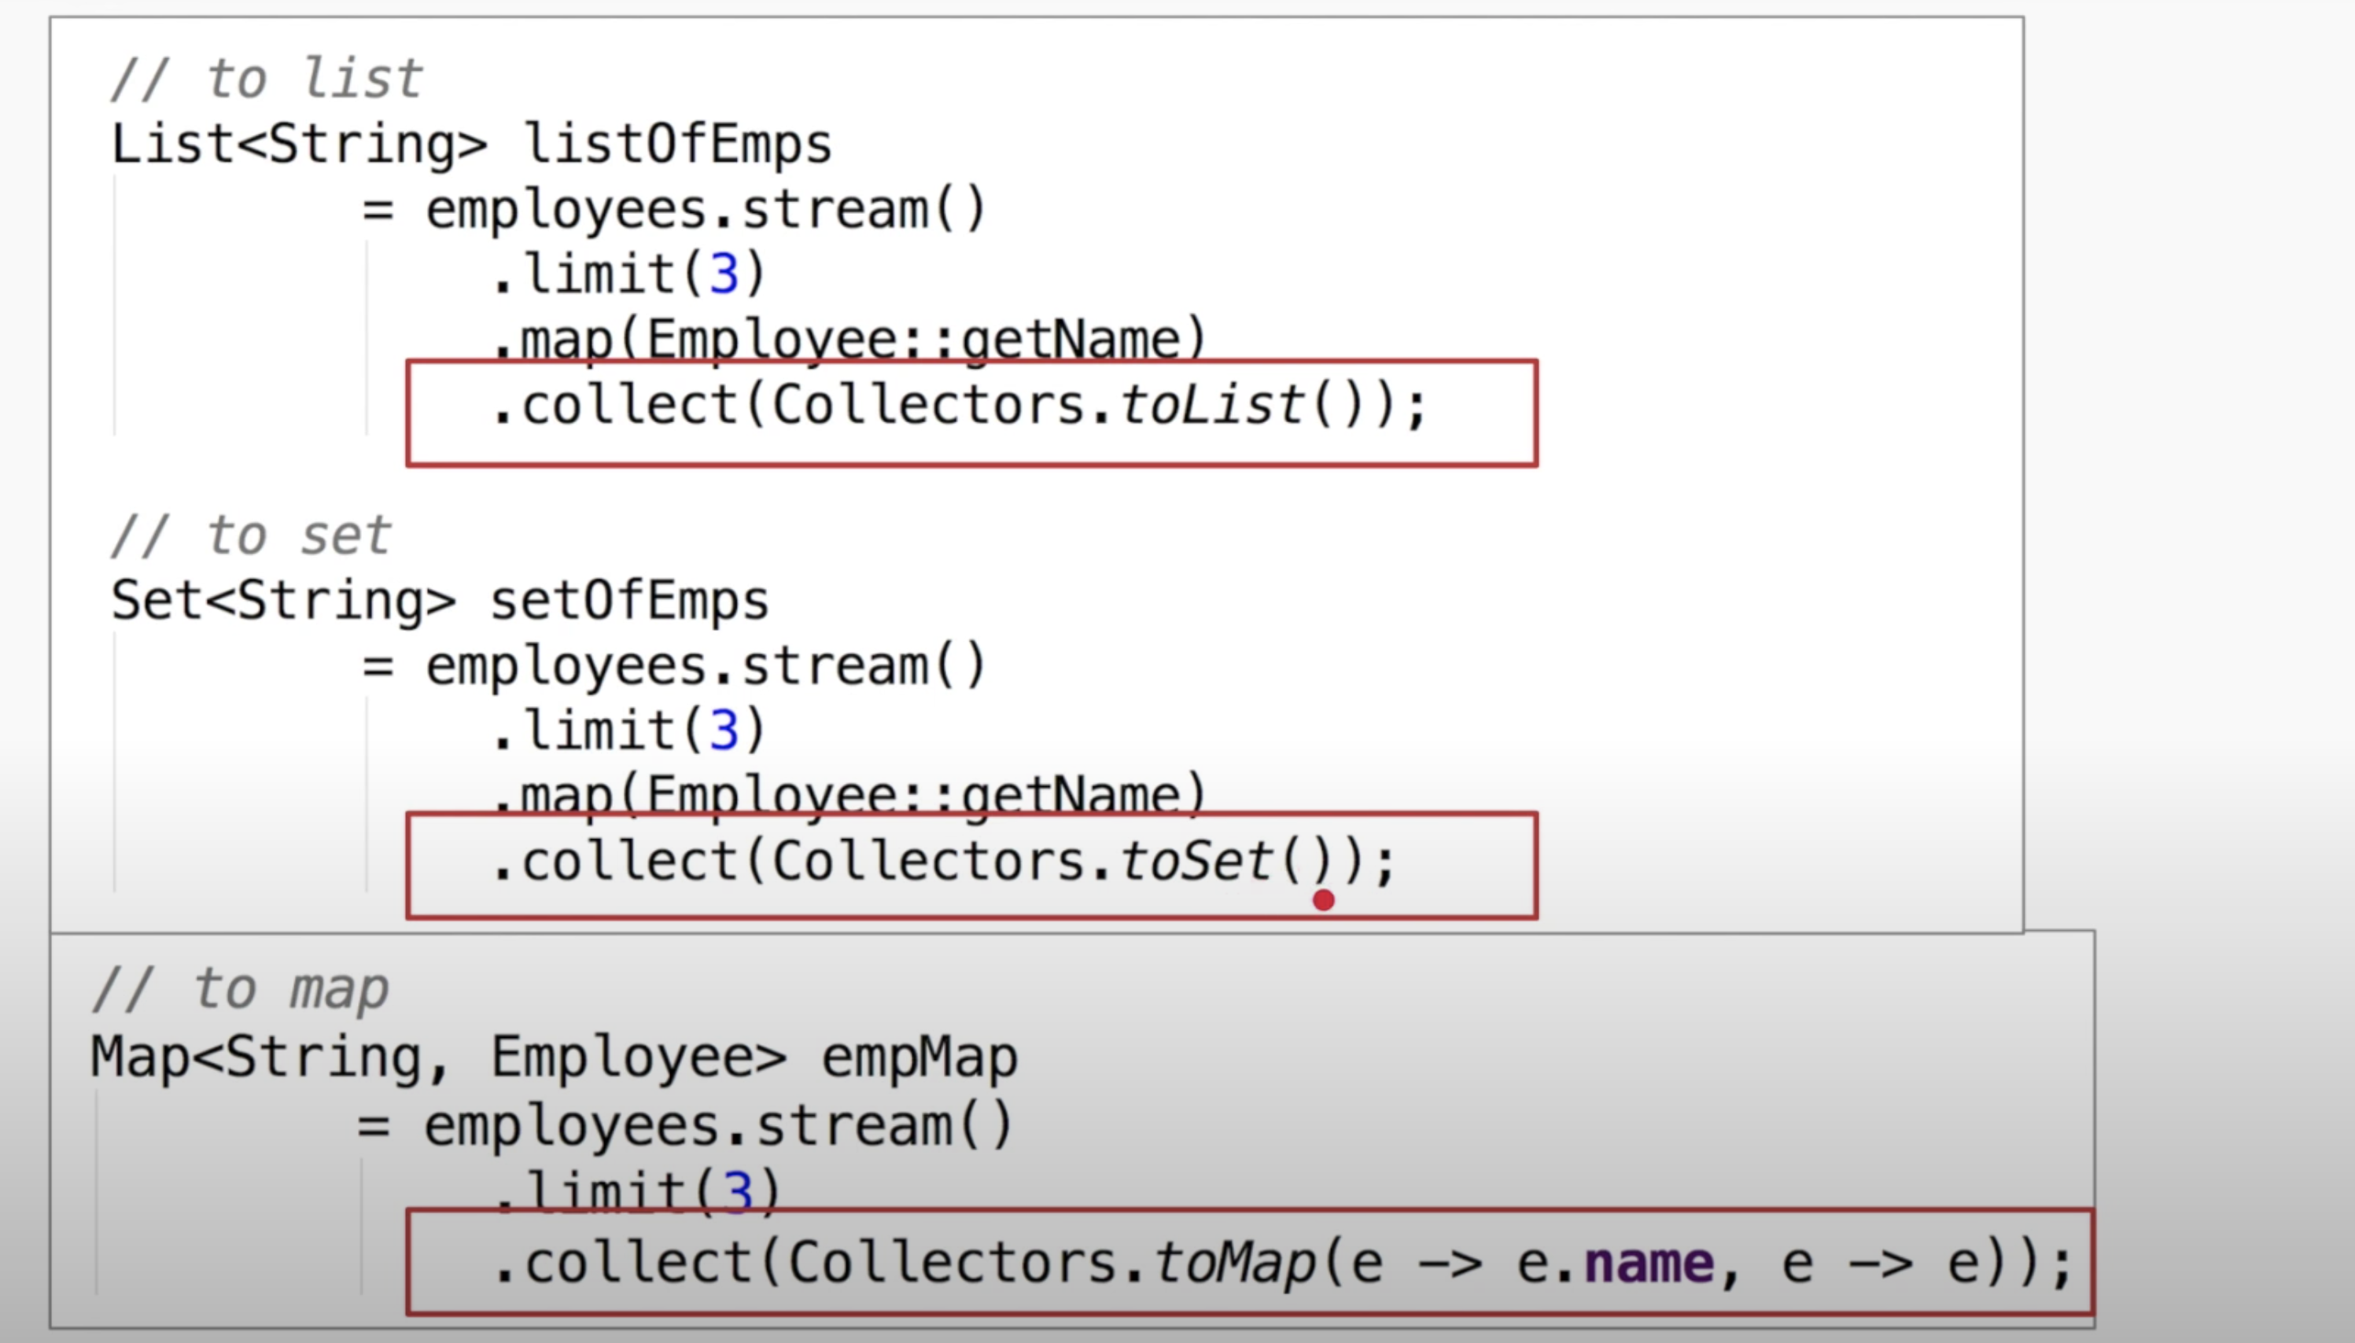
Collectors
Which are like sum, max, min and .... Operation in IntStream

Slide 15
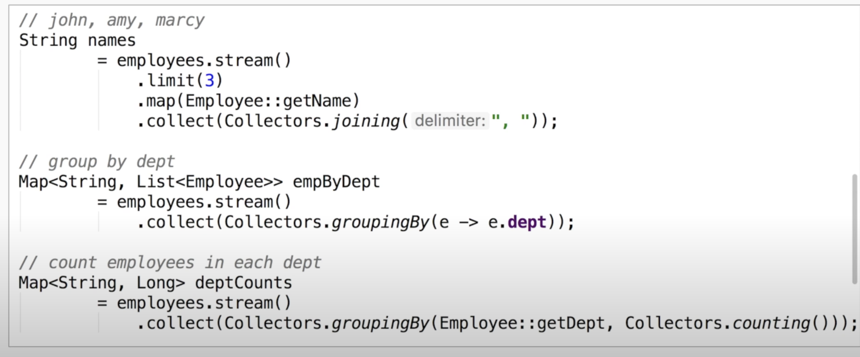
Collectors continues…

Slide 16
Stream API
The new java.util.stream package provides utilities to support functional-style operations on streams of values.
A common way to obtain a stream is from a collection:
Stream<T> stream = collection.stream();
Streams can be sequential or parallel.
Streams are useful for selecting values and performing actions on the results.

Slide 17
Stream operations
An intermediate operation keeps a stream open for further operations. Intermediate operations are lazy.
A terminal operation must be the final operation on a stream. Once a terminal operation is invoked, the stream is consumed and is no longer usable.

Slide 18
Characteristics of Streams
Streams are not related to InputStreams, OutputStreams, etc.
Streams are NOT data structures but are wrappers around Collection that carry values from a source through a pipeline of operations.
Streams are more powerful, faster and more memory efficient than Lists
Streams are designed for lambdas
Streams can easily be output as arrays or lists
Streams employ lazy evaluation
Streams are parallelizable
Streams can be “on-the-fly”

Slide 19
Creating Streams
From individual values
Stream.of(val1, val2, …)
From array
Stream.of(someArray)
Arrays.stream(someArray)
From List (and other Collections)
someList.stream()
someOtherCollection.stream()

Slide 20
Anatomy of the Stream Pipeline
A Stream is processed through a pipeline of operations
A Stream starts with a source data structure
Intermediate methods are performed on the Stream elements. These methods produce Streams and are not processed until the terminal method is called.
The Stream is considered consumed when a terminal operation is invoked. No other operation can be performed on the Stream elements afterwards
A Stream pipeline contains some short-circuit methods (which could be intermediate or terminal methods) that cause the earlier intermediate methods to be processed only until the short-circuit method can be evaluated.
Intermediate Methods
map, filter, distinct, sorted, peek, limit,
parallel
Terminal Methods
forEach, toArray, reduce, collect, min,
max, count, anyMatch, allMatch, noneMatch, findFirst, findAny, iterator
Short-circuit Methods
anyMatch, allMatch, noneMatch, findFirst, findAny,limit

